Slide 1
Project explanation
Cyber security & machine learning

Slide 2
Introduction
"Utilizing the comprehensive GUIDE dataset, the goal is to create a classification model that categorizes incidents as True Positive (TP), Benign Positive (BP), or False Positive (FP) based on historical evidence and customer responses. You need to train the model using the TRAIN.CSV dataset and provide evaluation metrics—macro-F1 score, precision, and recall—based on the model's performance on the TEST.CSV dataset”

Slide 3
Load dataset
Extract all files stored in Google Drive.
Mount Google Drive to Google Colab.
Read the CSV file GUIDE_train.csv into a Data Frame.
Create a variable named “df”

Slide 4
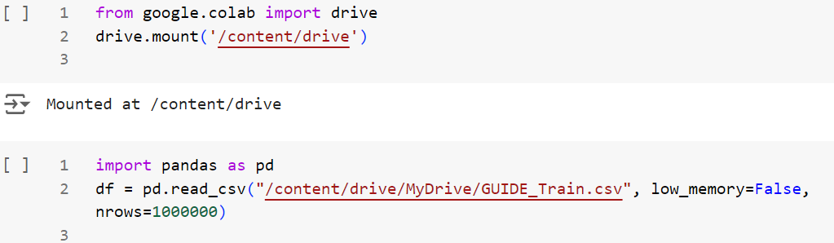
Load dataset - code

Slide 5
Drop columns
Our target column, 'IncidentGrade', depends on some columns that do not provide any predictive power.
Specifically, identifier columns help identify records but do not describe the characteristics of the incidents.
The following columns are dropped.

Slide 6
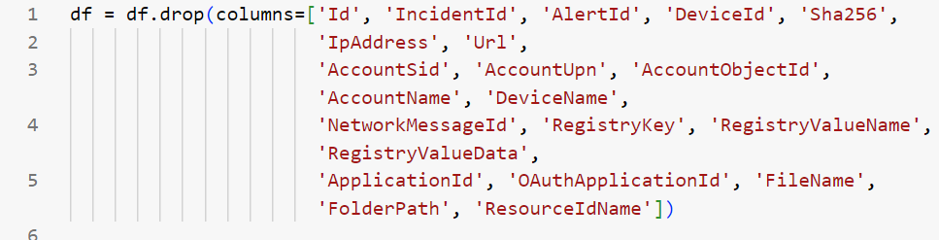
Drop columns - code

Slide 7
Duplicates
Check for duplicate rows in the dataset.
Find and identify any duplicate rows.
Drop the duplicate rows from the dataset.
After removing duplicates, the rows may no longer be ordered.
Reset the index of the dataset.

Slide 8
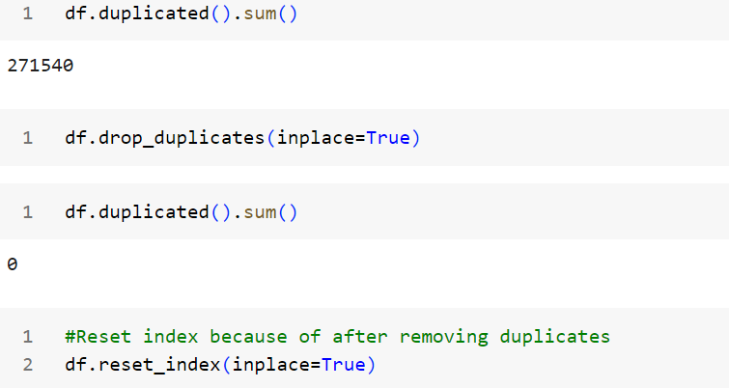
Duplicates - code

Slide 9
Drop null values
Some columns in this dataset have a large number of null values.
Calculate the percentage of null values in each column.
Drop columns with a large number of null values.
Drop all columns where more than 50% of the values are null.

Slide 10
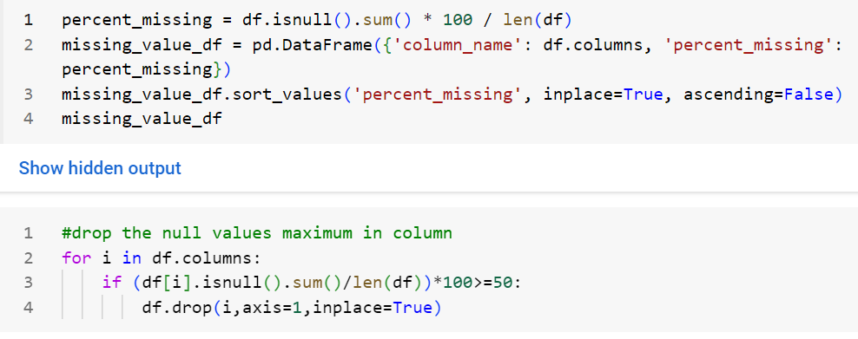
Drop null values - code

Slide 11
timestamp
The ‘Timestamp’ column contains multiple embedded time-related features. From this column, we extract the following features:
Year: The year the incident occurred.
Month: The month the incident occurred.
Hour: The hour of the day when the incident occurred.
Day of the Week: The specific day the incident occurred (Monday to Sunday).

Slide 12
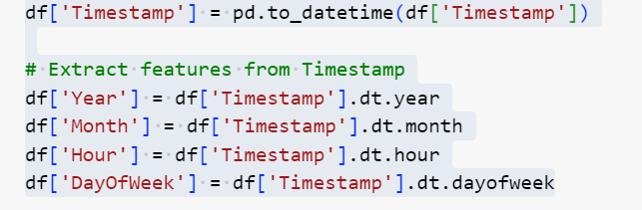
Timestamp - code

Slide 13
Timestamp extract
From the ‘Day of Week’ column, assign the values as weekend and weekday, encoding weekends as 0 and weekdays as 1. Assign the new column name ‘weekend’.
From the ‘Hour’ column, categorize the values based on time periods such as ‘night time’, ‘business hours’, and ‘other time’. Encode these values as 0,1 and 2 respectively, and create a new column named ‘time’.
From the ‘Month’ column, categorize the values into seasons: ‘winter’, ‘summer’, ‘fall’, and ‘spring’. Write a function to assign these values and create a new column named ‘season’.
the original columns ‘timestamp’ , ‘day of week’ , ‘hour’ , ‘month’ are dropped from the data frame , reducing redundancy and simplifying the dataset.

Slide 14
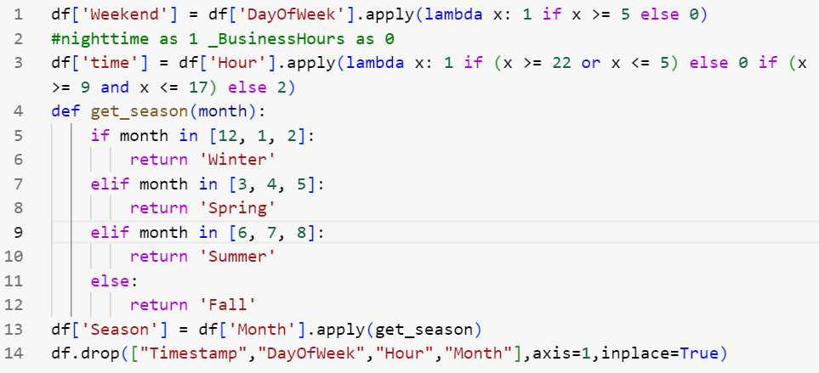
Timestamp extract - code

Slide 15
Chi2_contingency test
We took the features like 'year', 'weekend', 'time', 'season' and tested them with the target column 'incident grade’.
We used the chi2_contingency test for significant relationships between the two categorical variables.
It is decided by p-value. If the p-value is less than the alpha value, there is a significant relationship between them. If the p-value is greater than the alpha value, there is no significant relationship.
Here, the above features are coming in less than the alpha value, so all the features have a relationship with the target column.

Slide 16
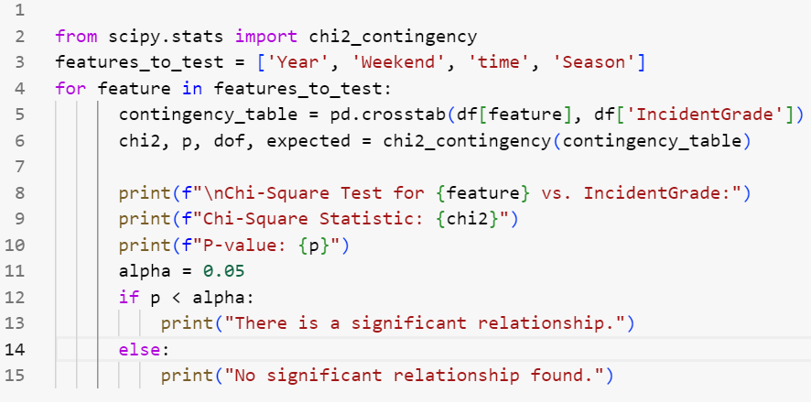
Chi2_contingency test - code

Slide 17
Top 5 in columns
Took some of the columns like 'OS Version', 'country code', 'state', 'city' and found the top 5 most frequently occurring values.
Calculate the total count of all values in these columns minus the sum of the top 5 counts. This represents the count of values that are not among the top 5.
The remaining values are encompassed in the 'others' category.
Below the code represents the 'OS Version' column. This same code can be applied to the remaining columns.

Slide 18
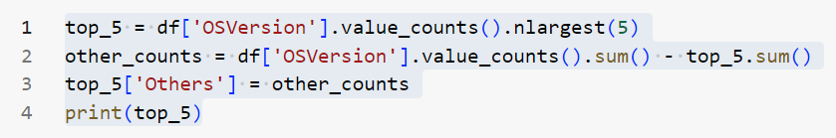
Top 5 in columns - code

Slide 19
mapping Top 5 in columns
We took some of the columns like 'OS Version', 'country code', 'state', 'city’.
From these columns, find the top 5 values and store them in a list.
Create a dictionary where each of the top 5 values is mapped to a numerical index starting from 0.
Assign the numerical value to the key 'others', which will be used to represent any value from these columns not among the top 5.
For encoding part,
If the value is one of the top 5 countries, it retrieves the corresponding numerical index from the mapping dictionary.
If the value is not among the top 5, it assigns the numerical value associated with 'Others’.
The resulting values are stored in a new column called ‘column encoded’
After encoding drop the original columns

Slide 20
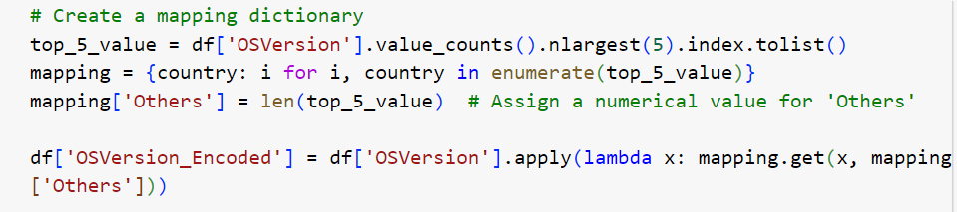
mapping Top 5 in columns - code

Slide 21
Label & ordinal encoder
Label encoding is applicable to the columns are ‘category’ , ‘incident grade’ , ‘entity type’ , ‘evidence role’ , ‘country code encoded’ , ‘ state encoded’ , ‘season’, because in these columns have no inherent order
Ordinal encoding is applicable to ‘OS version encoded’ and ‘OS family’ because these are inherent order

Slide 22
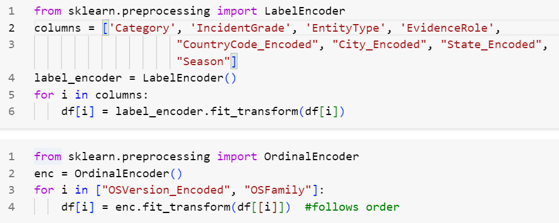
Label & ordinal encoder - code

Slide 23
Outlier detection
Check the outliers of all columns using boxplots for visualization.
Create a function named 'identify_outliers_IQR’.
First, we check the target column 'incident grade' and find no outliers.
Then, we check the remaining columns for outliers and find that some of them have outliers.
Then, store the features with outliers in a tuple and iterate over the column names in the tuple
Filter the DataFrame to remove outliers from the current column.

Slide 24
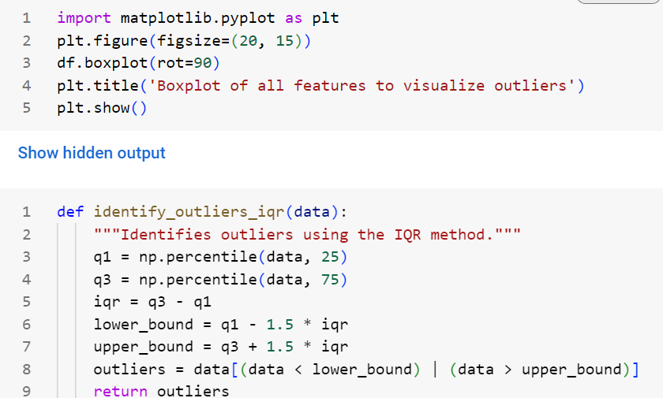
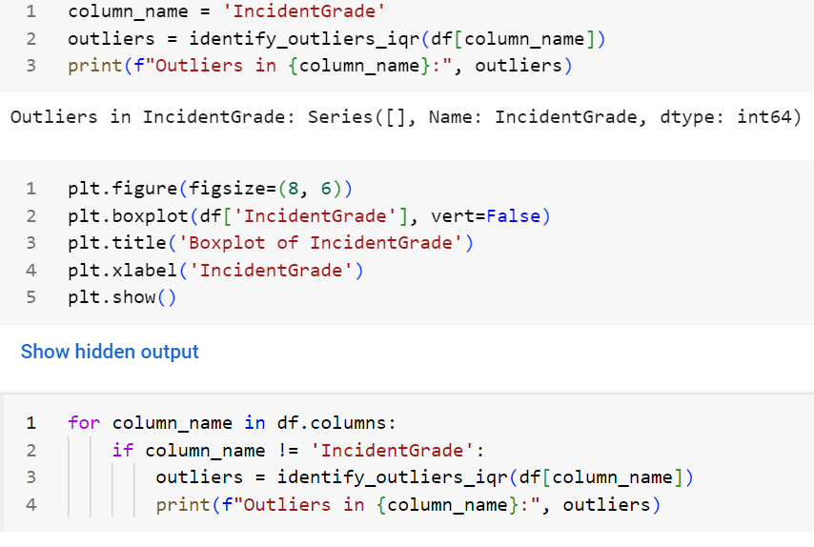
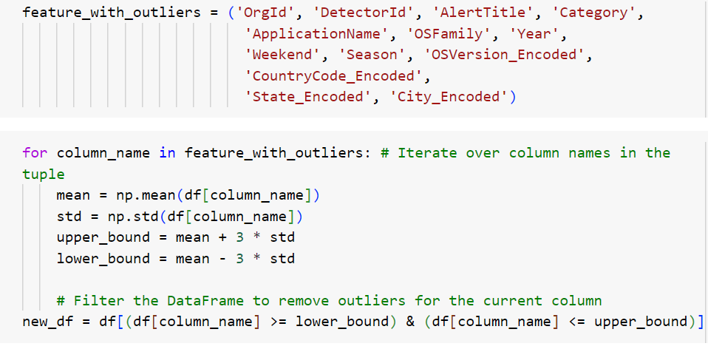
Outlier detection - code

Slide 25
Feature selection – chi2 test
Feature selection is crucial for machine learning algorithms
We used the chi-squared test for feature selection.
Store the target column in the variable 'n’.
Store the remaining columns in the variable 'm’.
Perform the chi-squared test and calculate the p-value.
Then, compare the p-value to the significance level of 0.05.
Select the features based on the chi-squared p-value.

Slide 26
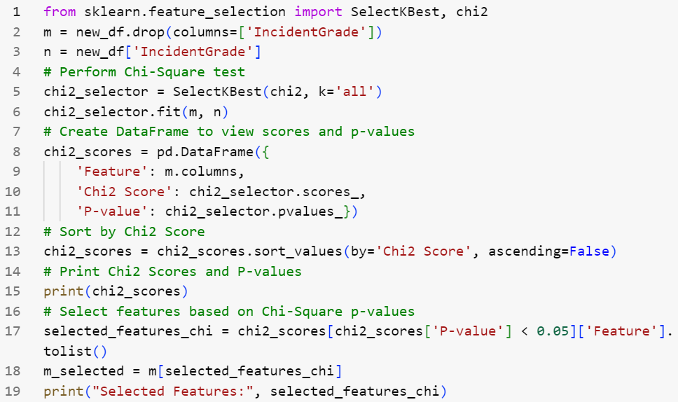
Feature selection – chi2 test code

Slide 27
Feature selection – anova test
We used the ANOVA test for feature selection.
Store the target column in the variable ‘p’.
Store the remaining columns in the variable ‘o’.
Perform the ANOVA test and calculate the p-value.
Then, compare the p-value to the significance level of 0.05.
Select the features based on the chi-squared p-value.
Both ANOVA and the chi-squared test suggest dropping the column 'Year'.

Slide 28
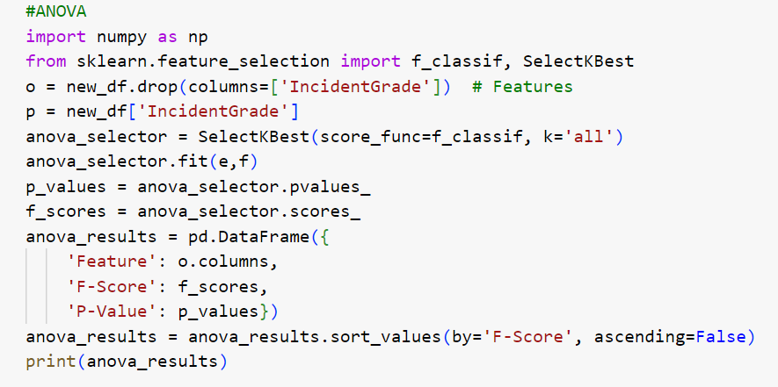

Feature selection – anova test code

Slide 29
Test dataset
Read the CSV file "GUIDE_test.csv" into a Data Frame.
Create a variable named "df1".
In the training dataset, implement the same preprocessing steps on the test dataset.
Now that we have the training and testing datasets, we can proceed to apply machine learning algorithms.

Slide 30
splitting
In the training dataset, we will split the data into training and validation sets.
Before splitting, assign the variables for the feature and target columns.
We will use stratification during the splitting process to maintain proportional representation of the groups.
In the testing dataset, assign the variables for the feature and target columns.
After this, start applying the machine learning algorithm.

Slide 31
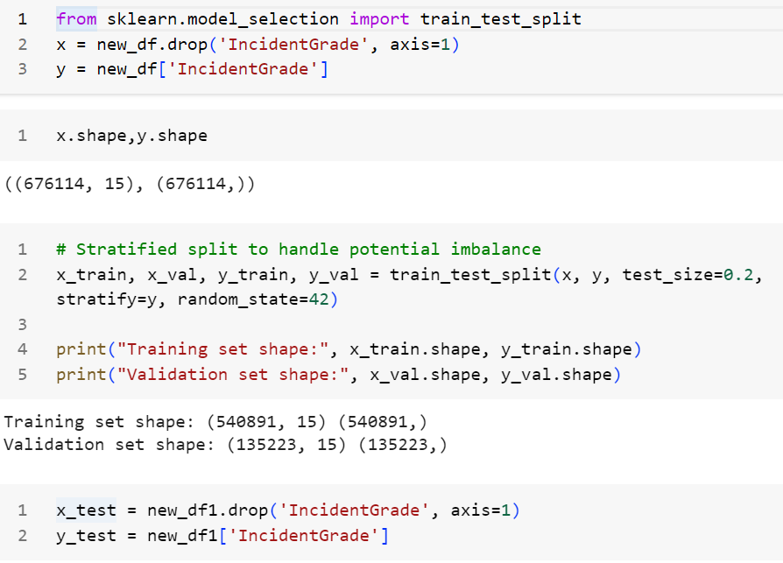
Splitting - code

Slide 32
Decision tree
First, we will run the model using the Decision Tree Classifier
Train the model using x_train and y_train
Next, predict y from x_test
After this, calculate the accuracy and generate the classification report.
The Accuracy is 90%

Slide 33
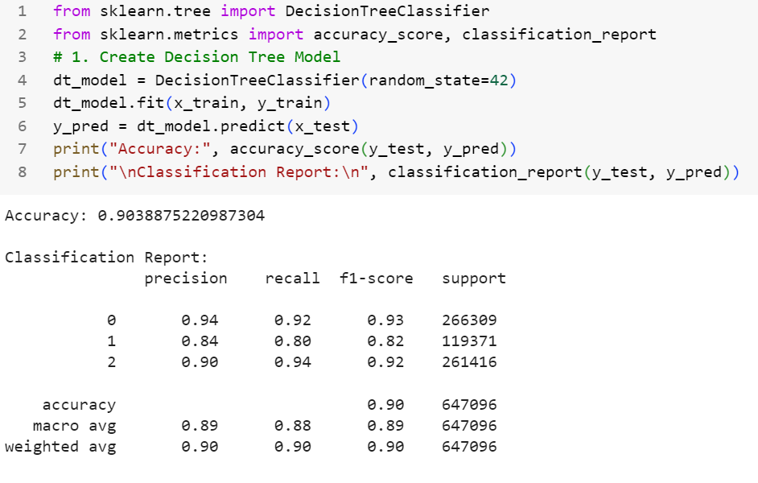
Decision tree - code

Slide 34
Random forest
Second, we will run the model using the Random Forest Classifier
Train the model using x_train and y_train
Next, predict y from x_test
After this, calculate the accuracy and generate the classification report.
The Accuracy is 88%

Slide 35
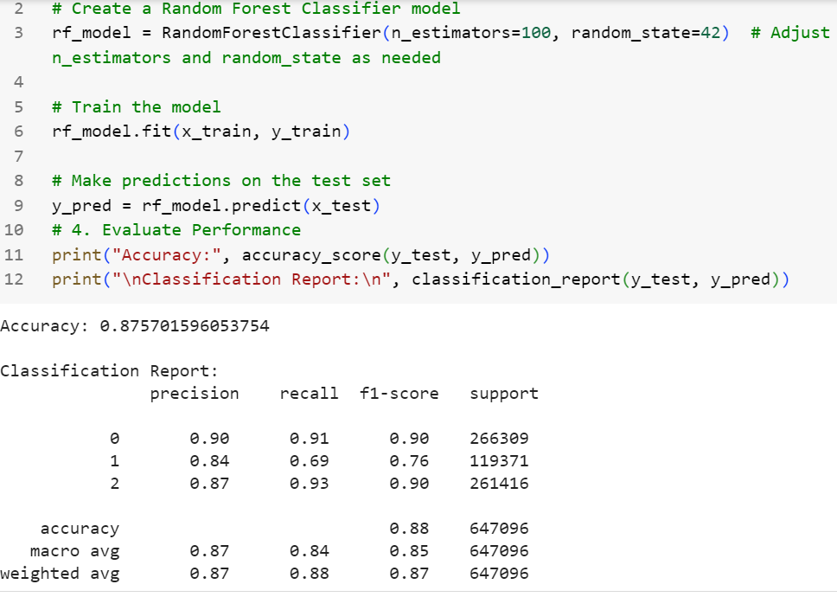
Random forest-code

Slide 36
xgboost
Third, we will run the model using the XGBoost Classifier
Train the model using x_train and y_train
Next, predict y from x_test
After this, calculate the accuracy and generate the classification report.
The Accuracy is 80%

Slide 37
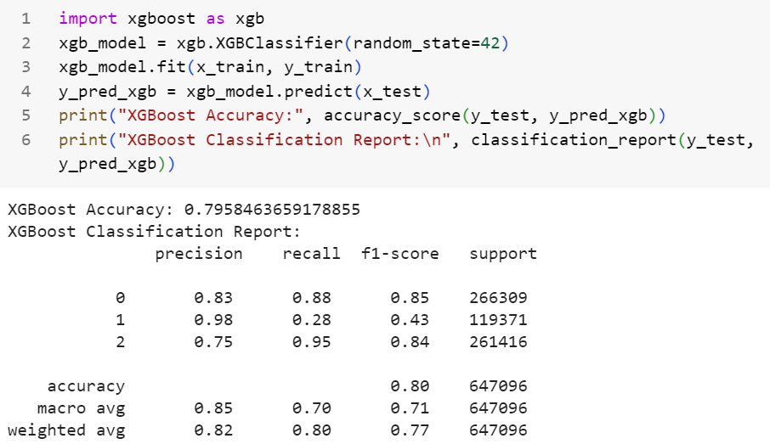
Xgboost - code

Slide 38
Imbalance - smote
Find the imbalance ratio of the dataset.
If the ratio is greater than 1.5, we will apply the SMOTE technique for resampling.
After resampling x_train and y_train, apply the Decision Tree Classifier model again.
We obtained a new accuracy and classification report.
The accuracy is 90%

Slide 39
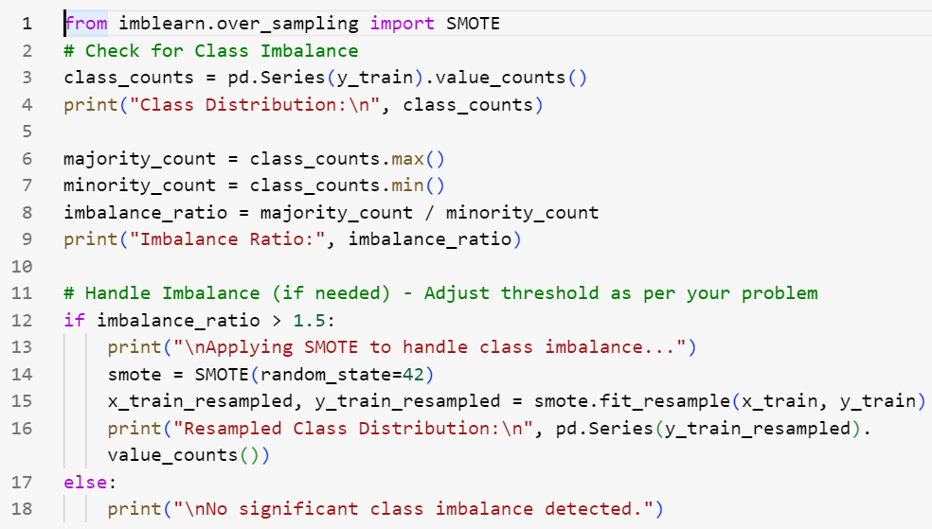
Imbalance – smote code

Slide 40
Hyper parameter tuning
Compare the three algorithms; the best algorithm is the Decision Tree Classifier.
To improve accuracy or maintain its current value, we will use a tuning process.
Here, we apply the Grid Search Cross Validation technique.
Define the parameter grid for the Decision Tree Classifier.
Initialize and fit GridSearchCV for the Decision Tree Classifier.
Find the best parameters for the Decision Tree Classifier.
After this, calculate the accuracy score and generate the classification report.
The accuracy is 90%.

Slide 41
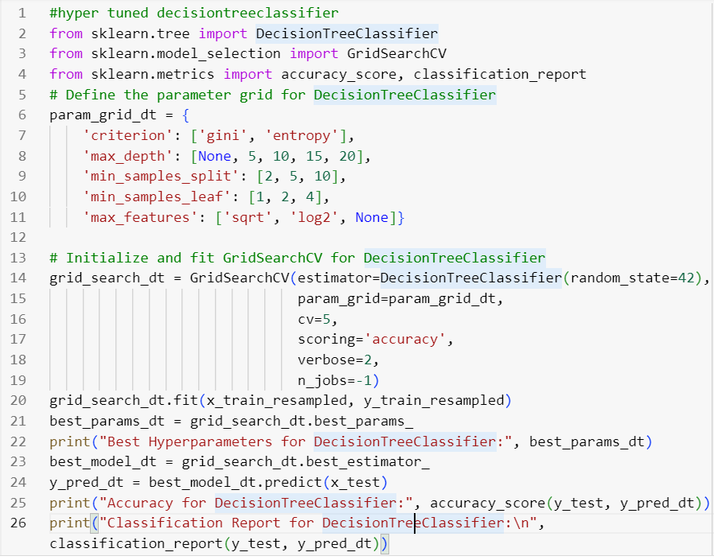
Hyper parameter tuning - code

Slide 42
Cv score & feature importance
After tuning the trained model, we find the cross-validation score of the model.
The model provides multiple cross-validation scores.
The average accuracy score is 95%.
Additionally, check the feature importance of the Decision Tree Classifier.
This importance helps determine how much impact each feature has on the algorithm.

Slide 43
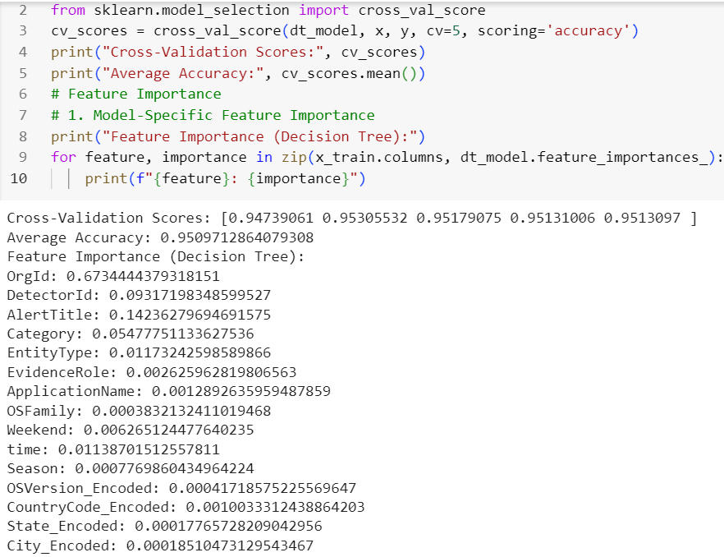
Cv score & feature importance - code

Slide 44
Error analysis & confusion matrix
Error analysis helps identify the specific types of errors the model is making, such as misclassifications, which can provide insights into its strengths and weaknesses.
error analysis is essential for refining a model, increasing its accuracy, and ensuring its robustness.
Also, calculate the confusion matrix, which is used to find the True Positives (TP), True Negatives (TN), False Positives (FP), and False Negatives (FN).

Slide 45
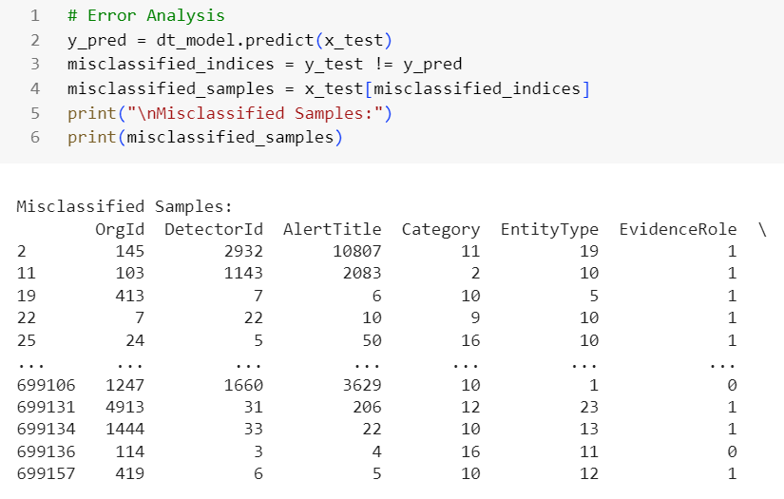
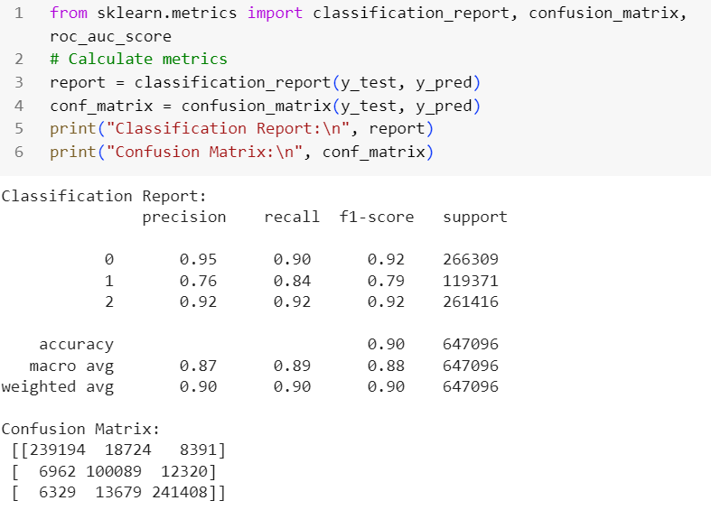
Error analysis & confusion matrix - code

Slide 46
conclusion
In conclusion, the classifier algorithm effectively distinguishes between the different classes in the dataset. Through model evaluation metrics such as accuracy, precision, recall, F1-score, and the confusion matrix, we assess the model’s performance and ability to correctly predict class labels. Depending on the chosen algorithm and tuning techniques like hyperparameter optimization or cross-validation, the model can be fine-tuned to achieve higher accuracy and reduce errors. While Decision Tree, Random Forest, and XGboost are commonly used classifiers, selecting the best model depends on the dataset characteristics, feature importance, and overall performance across various metrics.

Slide 47


